Slide 1


21 Days
By
Jay, Nishita, Haixuan, Stacy, Shayna

Slide 2

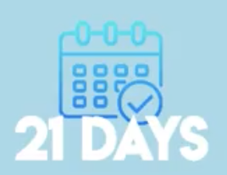



Goals for this Project
Ensure that sustainability becomes a part of our daily life as we work together to save the environment
Help users build and retain habits by keeping them constantly engaged
Building a supportive community to keep our users focused and motivated

Slide 3
Importance of these Goals
“Climate change is the defining issue of our time, and we are at a defining moment”. - United Nations
With shifting weather patterns and rising sea levels, drastic action today is necessary to ensure a tomorrow. However, while most people would agree that something needs to change, few follow through on this sentiment and actively make sustainable choices. In order to help individuals, take those steps, we plan on incorporating gamification and a community/ social aspect to this application to keep users motivated.

Slide 4




Steps taken to achieve the Goal
Target Market Research through Surveys
Website showcasing our ideology
Beta Testing using Reminders and Notifications
Implementation of the Application

Slide 5
The Final Solution

Slide 6






Achieving our goals
Structure :–
Give people a list of simple green tasks, encourage them to to follow it, and they’ll stick to the habits we create.
Incentives :–
By gamifying the experience, participants will positively associate environmentally-conscientious habits with fun activities, which contributes to creating that structure

Slide 7
Current Limitations/Future Directions
01
02
03
Expand tasks and community to other schools
Integrate with currently used apps
Conduct long-term testing of user retention

